Slide 1
Booking System for Airlines Company
Pure Java Code

Slide 2
Three types of seats: first class, business and economy
Airline Admin: Create and update each type of seat, set the total number of seats per flight
Airline Manager: Approve new prices or updates
When a customer buys a ticket, the system should be able to calculate how many seats are left. If all seats have been purchased, the application should not let customers purchase more seats.
Customers should be able to select their seats by selecting the following options
Departure
destination city
Travel date
Number of travelers
Flights are displayed to customers when they select their seats and confirm their flight itinerary booking
When the customer approves the itinerary, the customer will be asked to pay and a page with the total price should be displayed.
When a customer presses the pay button, the transaction is considered completed and the seat is marked as sold.
Once a seat is sold, send the customer an email with their flight itinerary.

Slide 3
Four Classes
Flight
Airline Admin
Airline Manager
Customer Interface

Slide 4
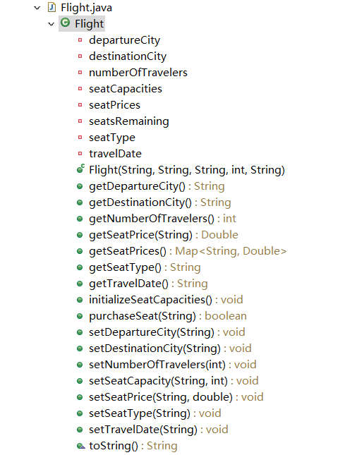
Flight Class
Notes:
定義變量，構造器，getset方法，重寫tostring方法打印出來

Slide 5
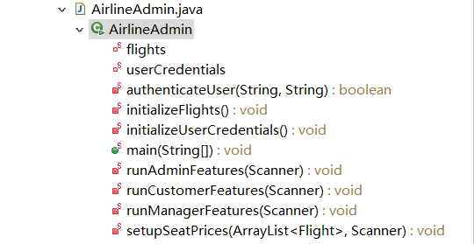
Airline Admin Class

Slide 6
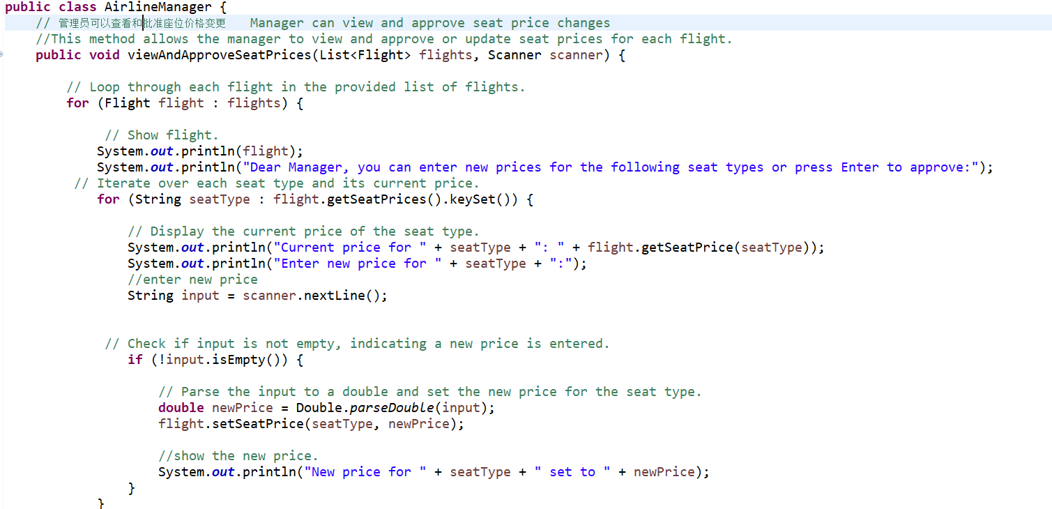
Airline Manager Class

Slide 7
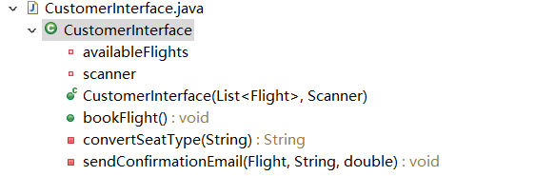
Customer Interface Class

Slide 8
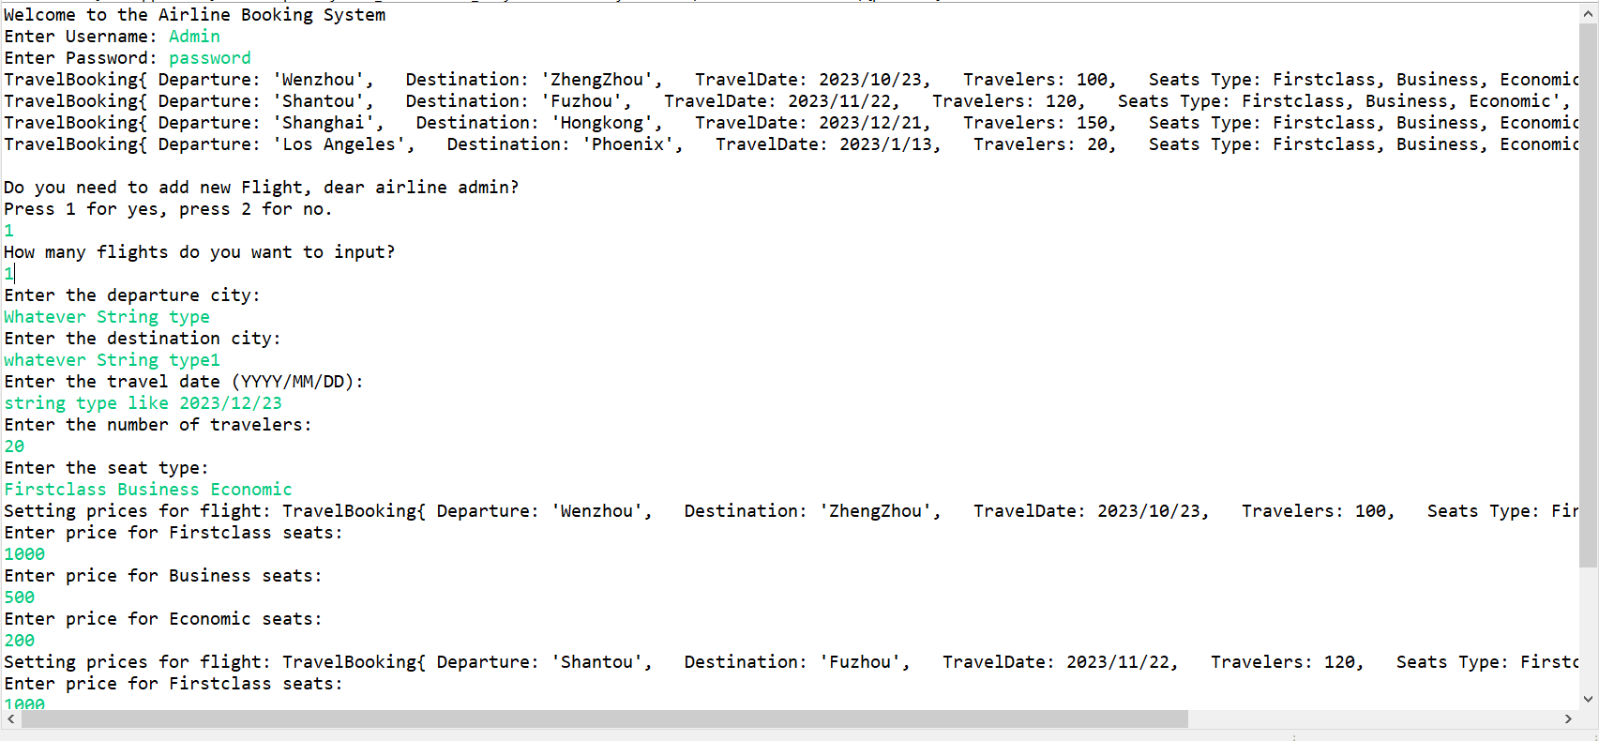

Slide 9
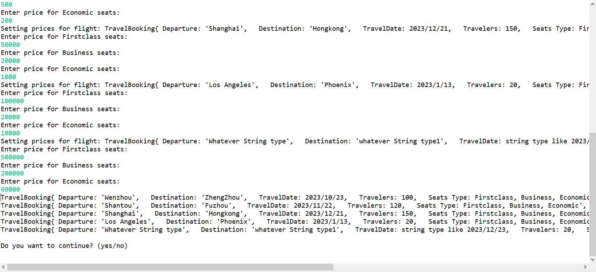

Slide 10
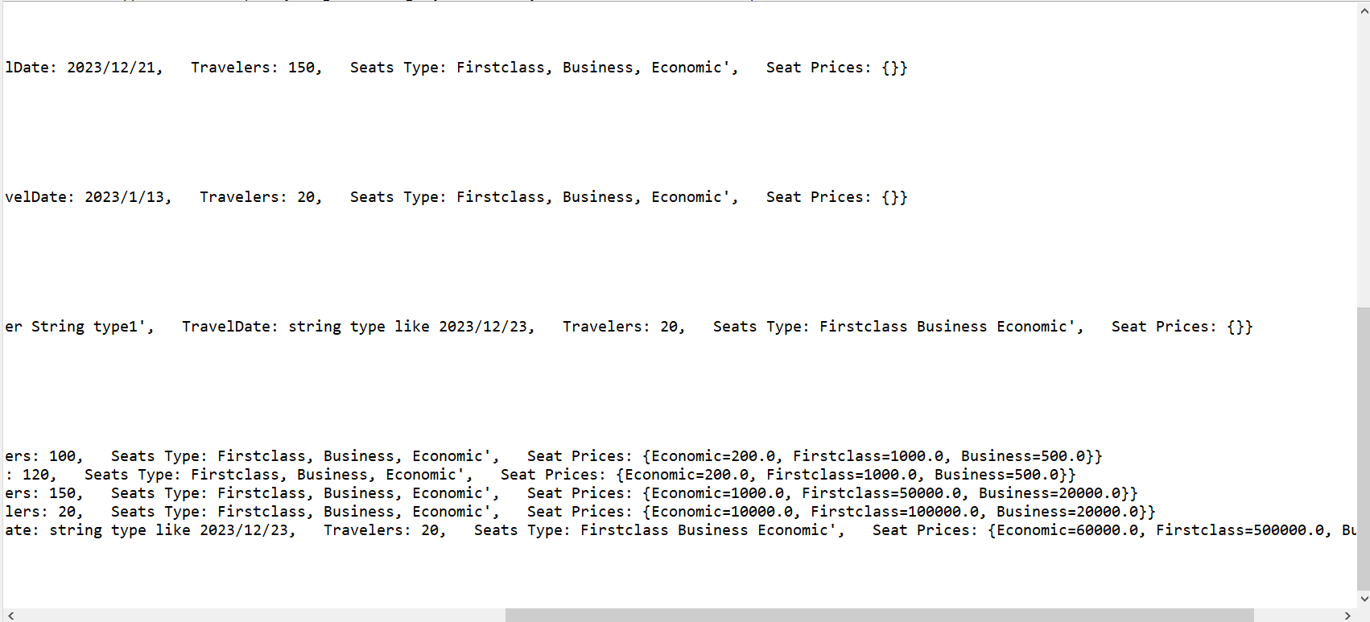

Slide 11
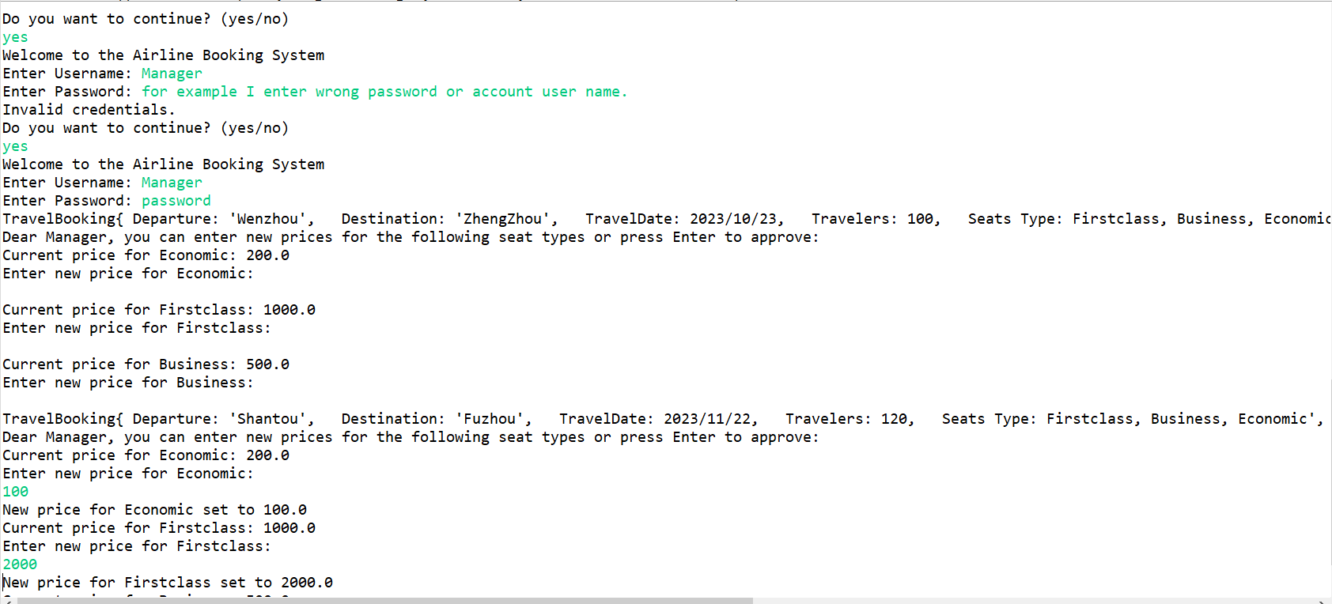

Slide 12
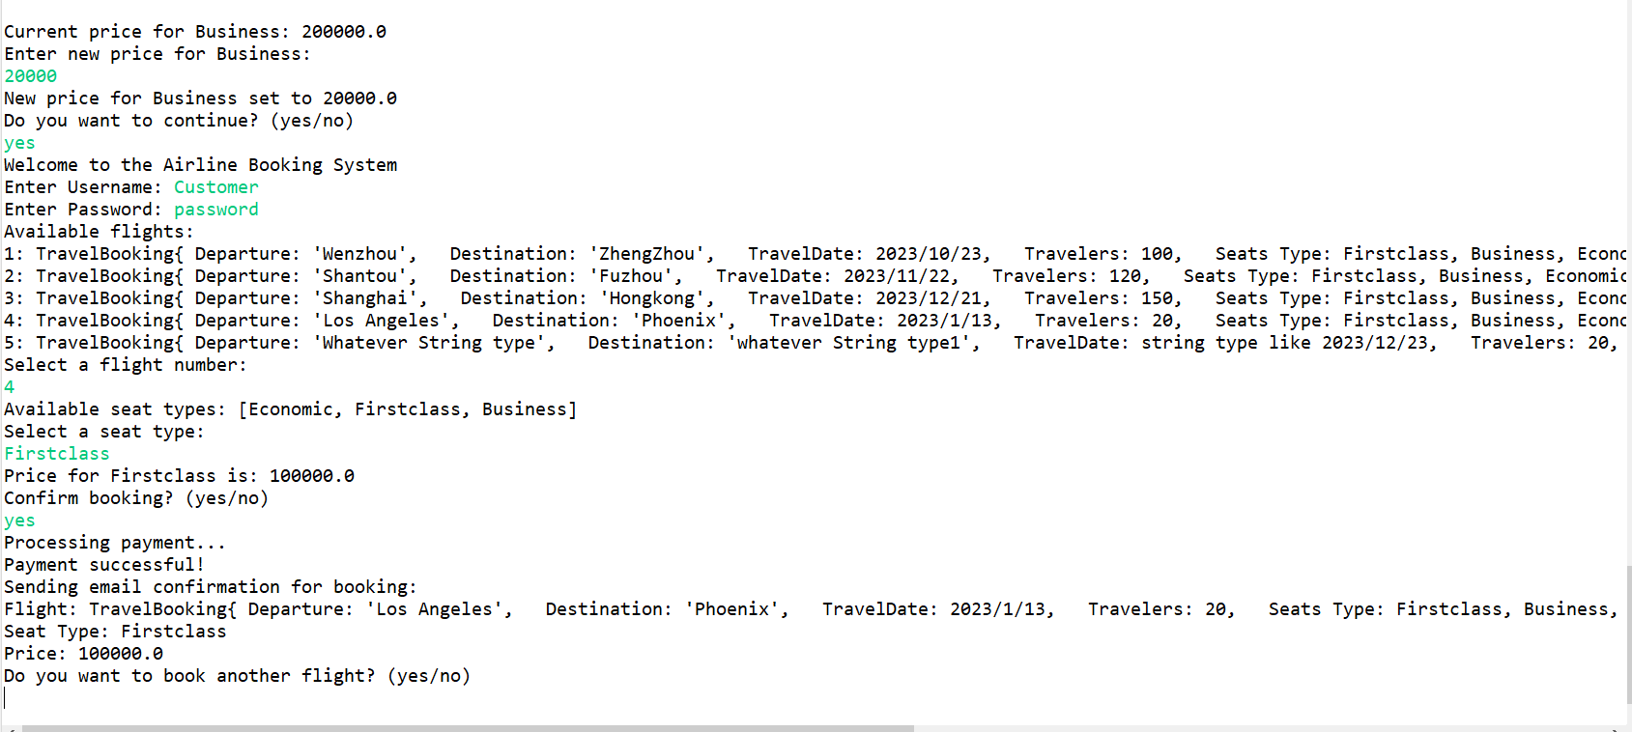

Slide 13
